Slide 1

AATMNIRBHAR BHART STORE TM
WELCOME TO ABS
Made for INDIA , Made in INDIA ...

Slide 2

What does Aatmnirbhar Bhart Store means:
ABS is a concept to help , support and promote Goods that are made in INDIA and made for INDIA . By doing this many venders , shopkeepers , household and small scale companies which are situated in INDIA get more Profit margin and also employment at the same time .
ABS supports - Aatma Nirbhar Bharat Abhiyan' package will help India in reviving the economy focus on land, labour, liquidity and laws and will benefit farmers, workers, taxpayers, MSMEs and cottage industry.

Slide 3

TEAM MEMBERS FOR THE PROJECT:
This project idea was only possible because of our team members and their efforts, following are the names of our team members:
SUNAINA BHARATI - 4067
AARYA VIRA – 4033
BHAVESH BALDANIYA – 4083
VIKAS MOURYA – 4057
KANHAIYA DUBEY - 4039

Slide 4

HOME PAGE:
Home Page is the first impression of our project to the users . We have many options available for the end users to navigate easily to our ABS Website . Here are some of the options listed below:
Search Box – to search for any required product on Website
Account – to visit to user account
Three Lines – to navigate to other pages of Website
Buy Now – to Buy any required Product
My Cart – to Add the user product to Cart Menu of the user on Website

Slide 5
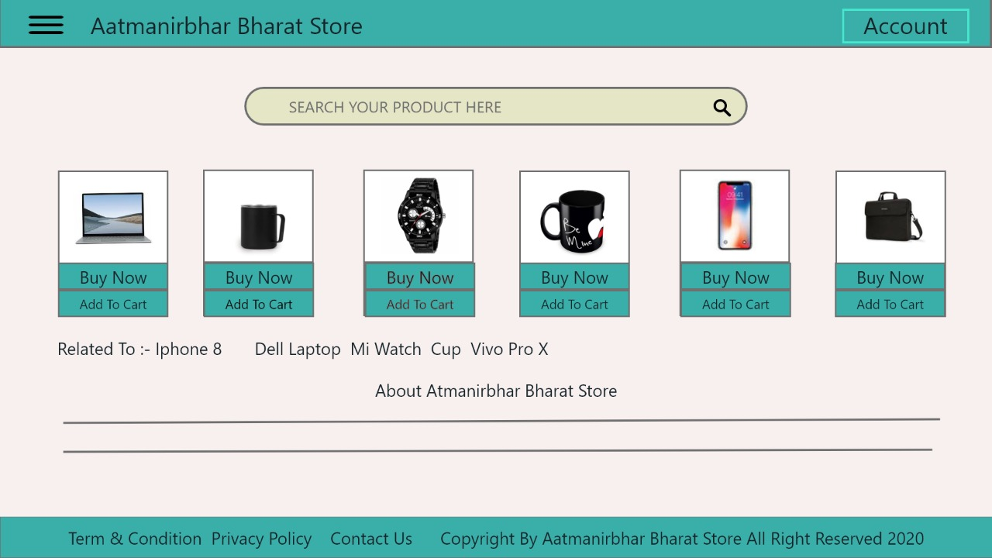

Slide 6

REGISTER PAGE:
Register Page is the second page after Home Page . This page is for users to First Register and creating an account on ABS, Here are some fields that are necessary to fill by the user to create an account are as follow:
Full Name
Email Address
Phone Number
Creating a Password
Conforming user Password

Slide 7
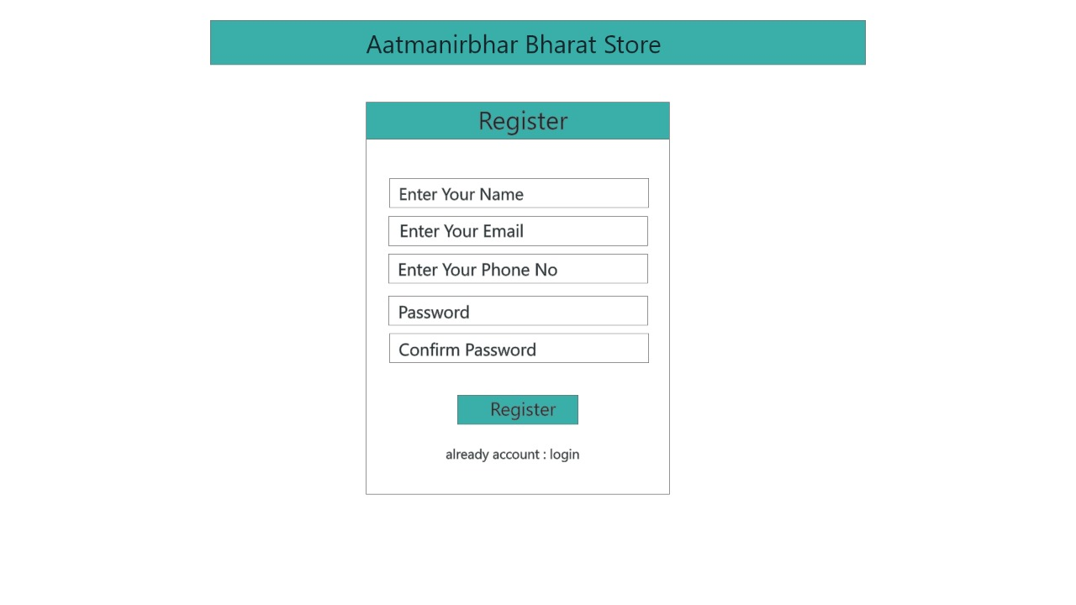

Slide 8

LOGIN PAGE:
Login Page is for user to login to ABS store and to visit it , Once user have created an account on ABS they can come on Login Page to Navigate to our Website , Here are some fields that are necessary to fill by the user wile Login in to the account are as follow:
Enter Email Address or Phone Number
Password for the Account

Slide 9
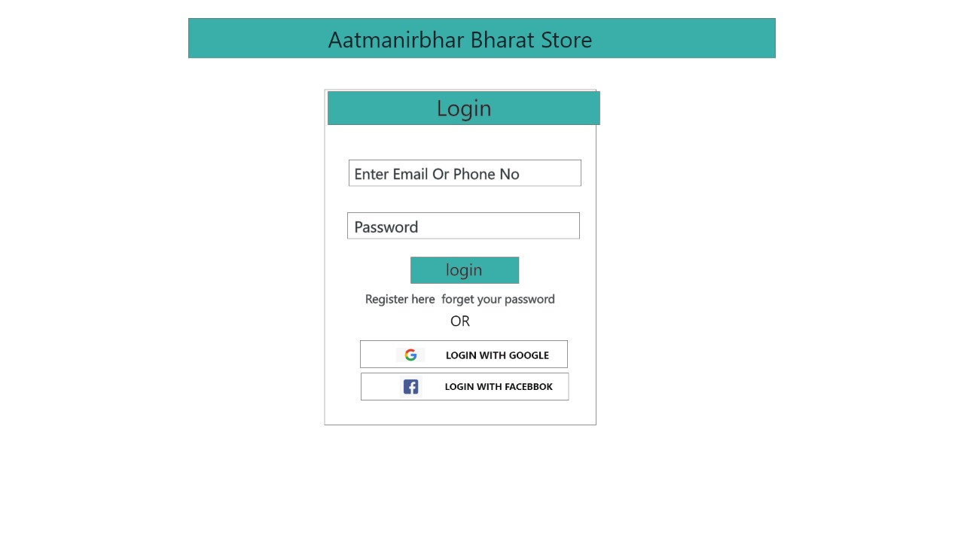

Slide 10

PRODUCT PAGE:
Product Page is the most important page of our project. Here we are demonstrating our Products that are made in INDIA. Here we again have various options for user convince to navigate to our store and they are as follow:
Three Lines – to directly go from Product Page to some other page
Account Option – to visit user account
Categories Option – to search for Product which user want to buy such as Mobile , Clothes etc…
Buy Now Option – to buy any required Product
Add To Cart Option – to directly add any product to Cart Menu

Slide 11
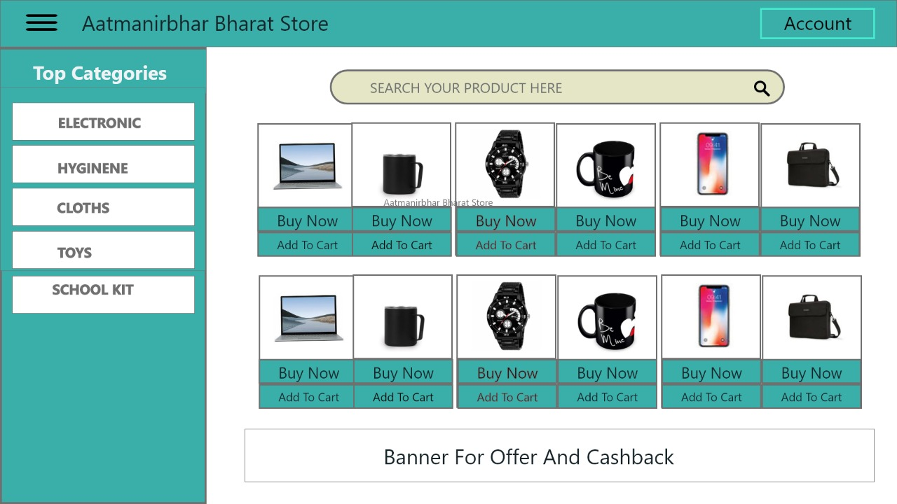

Slide 12

MY CART PAGE:
My Cart Page represents the product or services that the End User have saved for Purchasing , Here are some options that will guide the user to navigate to the page and they are as follow :
Three Lines – to navigate to some other page of the Website
Start Shopping Option – to start purchasing the product
Buy Now Option – to Buy that particular product
Add To Cart Option – to add any product to Cart Menu

Slide 13
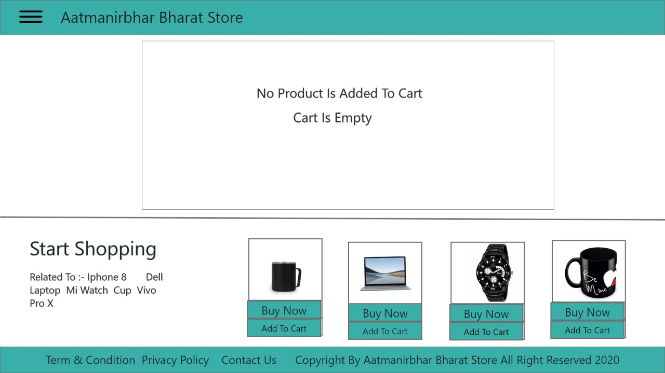

Slide 14

PAYMENT PAGE:
Payment Page is the page for adding payment option as well as to add Final Delivery location of your Place , Here are some fields that are necessary to fill by the user wile doing Payment for the Product and they are as follow:
Payment Option:
Here user need to select any one Radio Button out of 3 Payment Option (i.e. COD , GOOGLE PAY OR PAYTM)
Delivery Option:
Here user need to fill the Proper Address , Pin-code , Nearest Landmark etc..

Slide 15
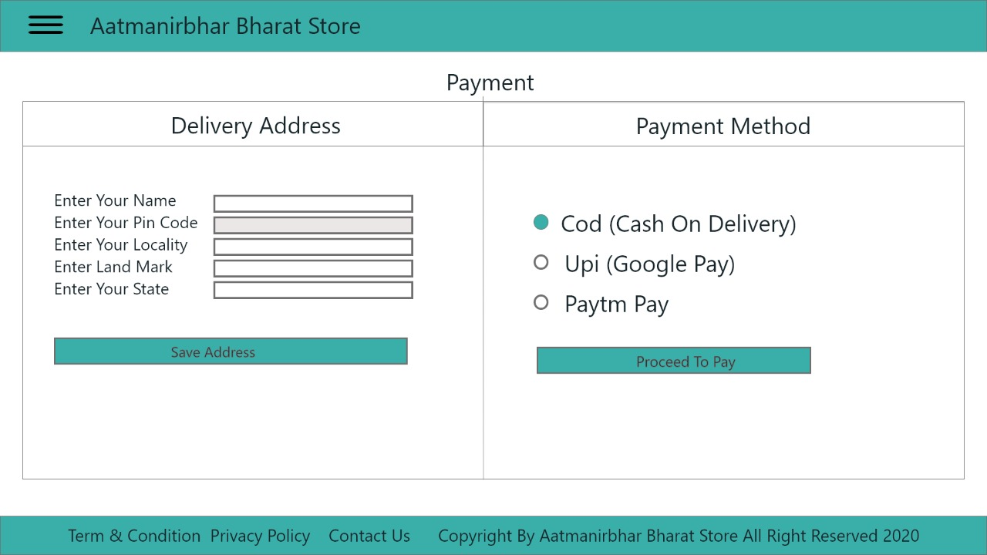

Slide 16

MARKETING PAGE:
Marketing Page is to support and help the Venders and Shopkeepers of INDIA to promote their product and to also support Make in INDIA goods and services . Here end user will get an benefit of Offer Coupons on the product they buy from ABS
Liquidity infusion and direct cash transfers into the accounts of laborers and daily-wage earners are helpful for their survival during the lockdown.
Long-term modifications in critical sectors keep them globally competitive and attractive.

Slide 17
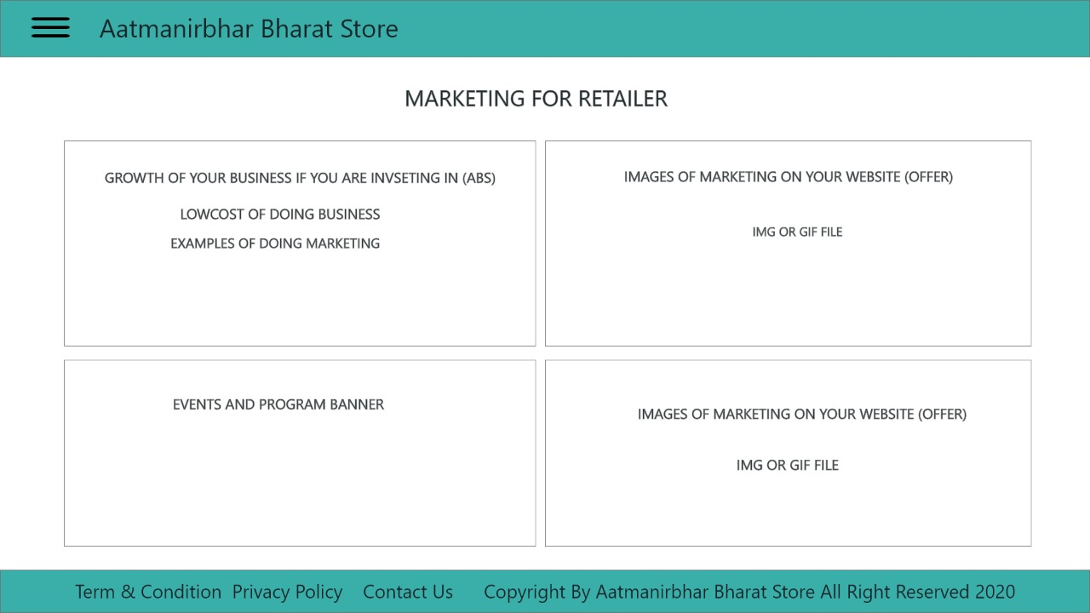

Slide 18

CONTACT US PAGE:
Contact Us Page is the most important page in terms of end user , through this page end user can Communicate the difficulties faced by him/her to our team . The end user need to fill a particular form to solve his/her query and the form consist of following questions:
Name of the consent person
Email Address of that person
Subject for the query
Query faced by that person

Slide 19
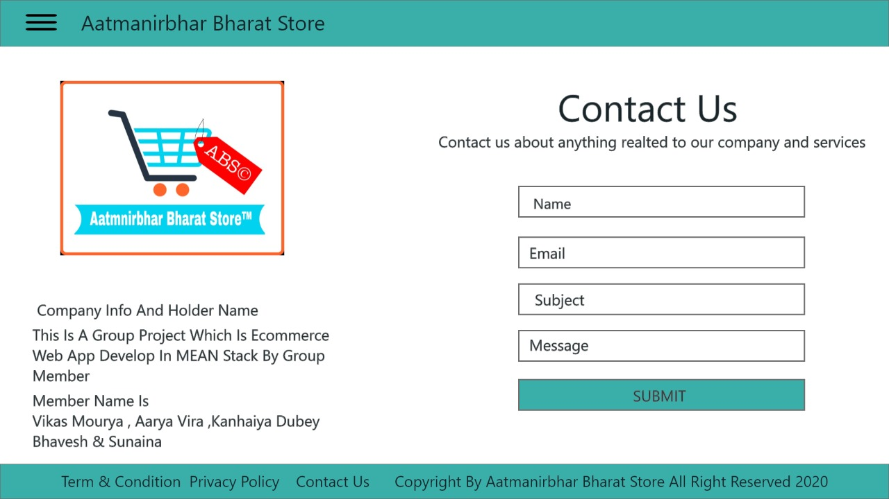

Slide 20


